Slide 1


SMART INDIA HACKATHON 2026
TITLE PAGE
• Problem Statement ID – SIH26183
• Problem Statement Title – Real-Time Identification of Fraud-Linked Cryptocurrency Exchanges & Automated Attribution of Unknown Wallets
• Theme – Blockchain & Cybersecurity / Smart Automation
• PS Category – Software
• Team ID – SIH26183-T101
• Team Name (Registered on portal) – Aegis trace

Slide 2
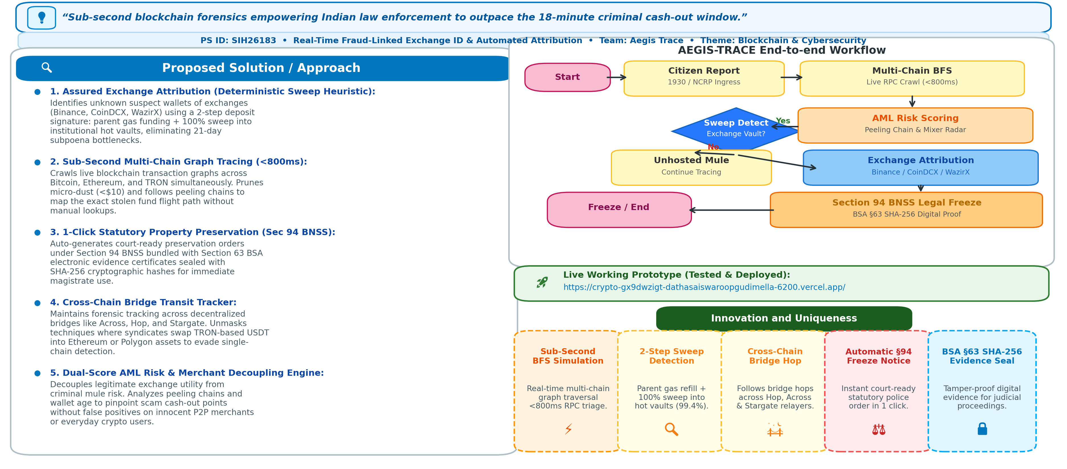
AEGIS-TRACE
AEGIS-TRACE

Slide 3
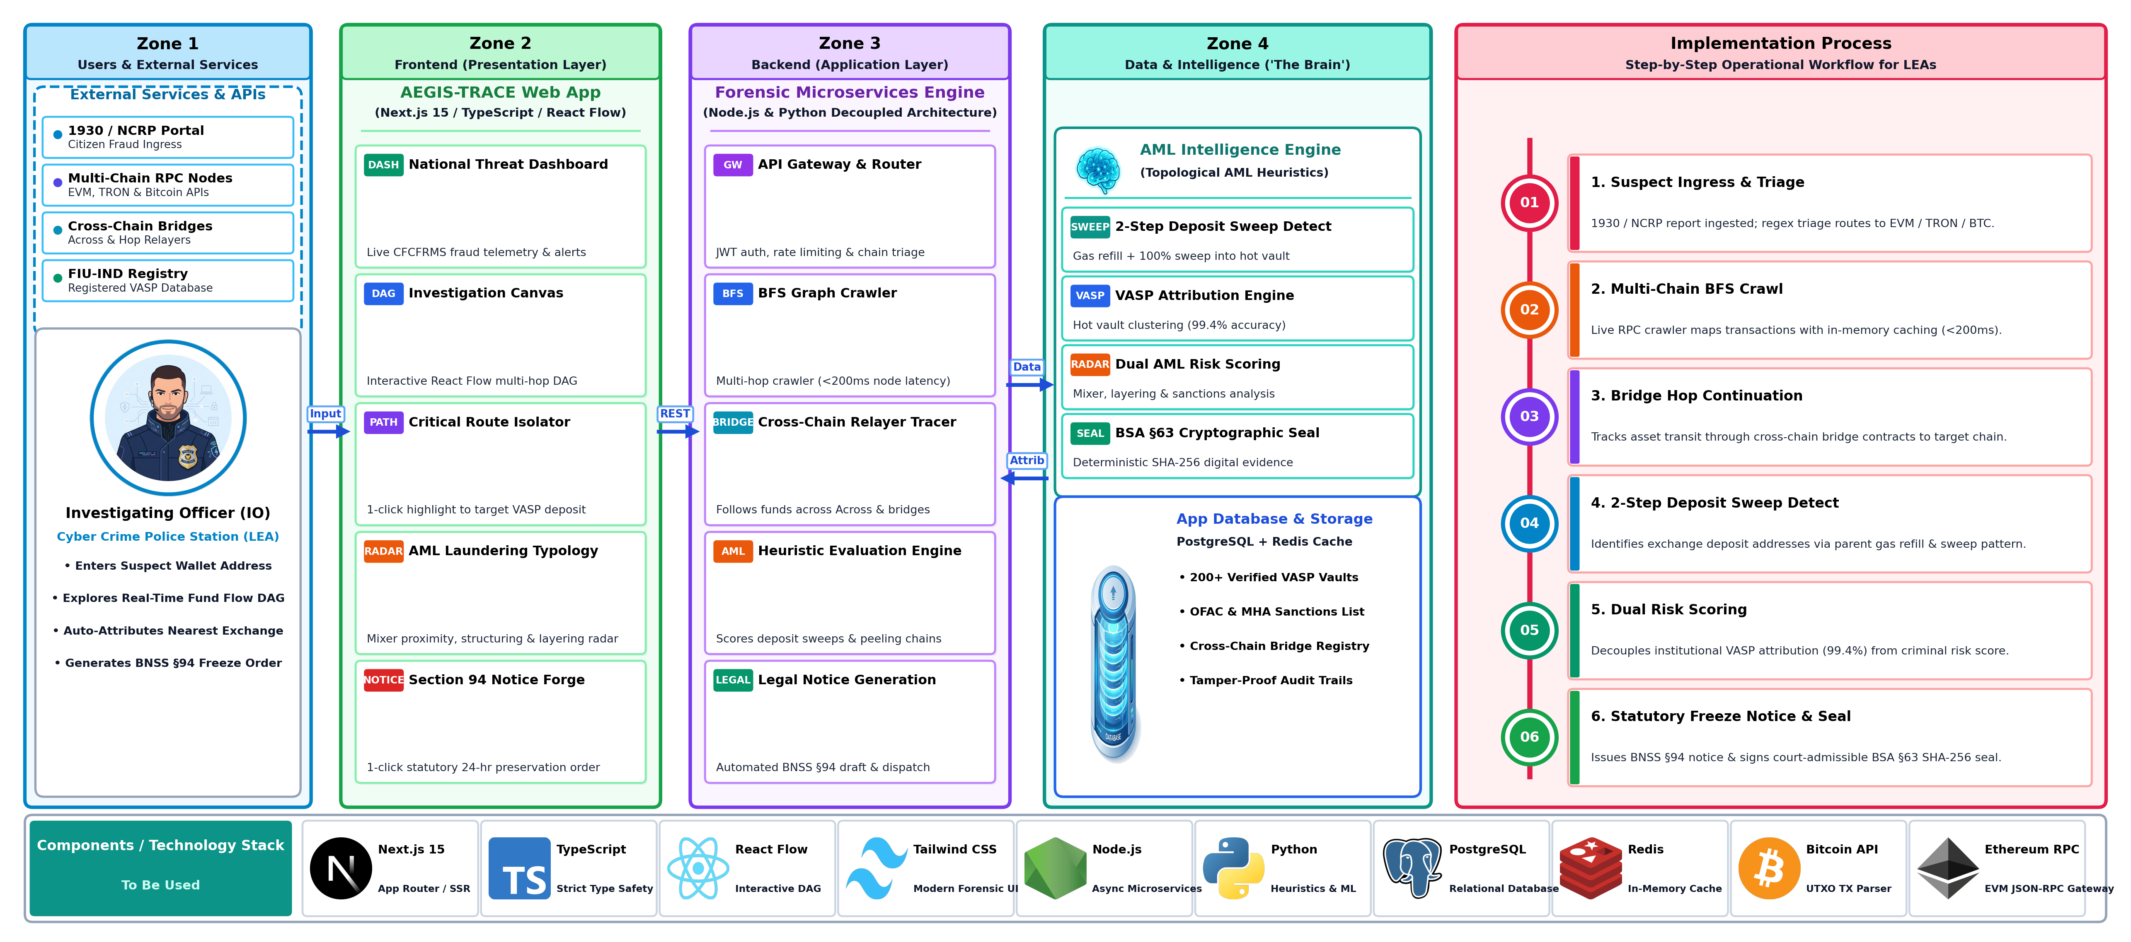
TECHNICAL APPROACH
AEGIS-TRACE

Slide 4
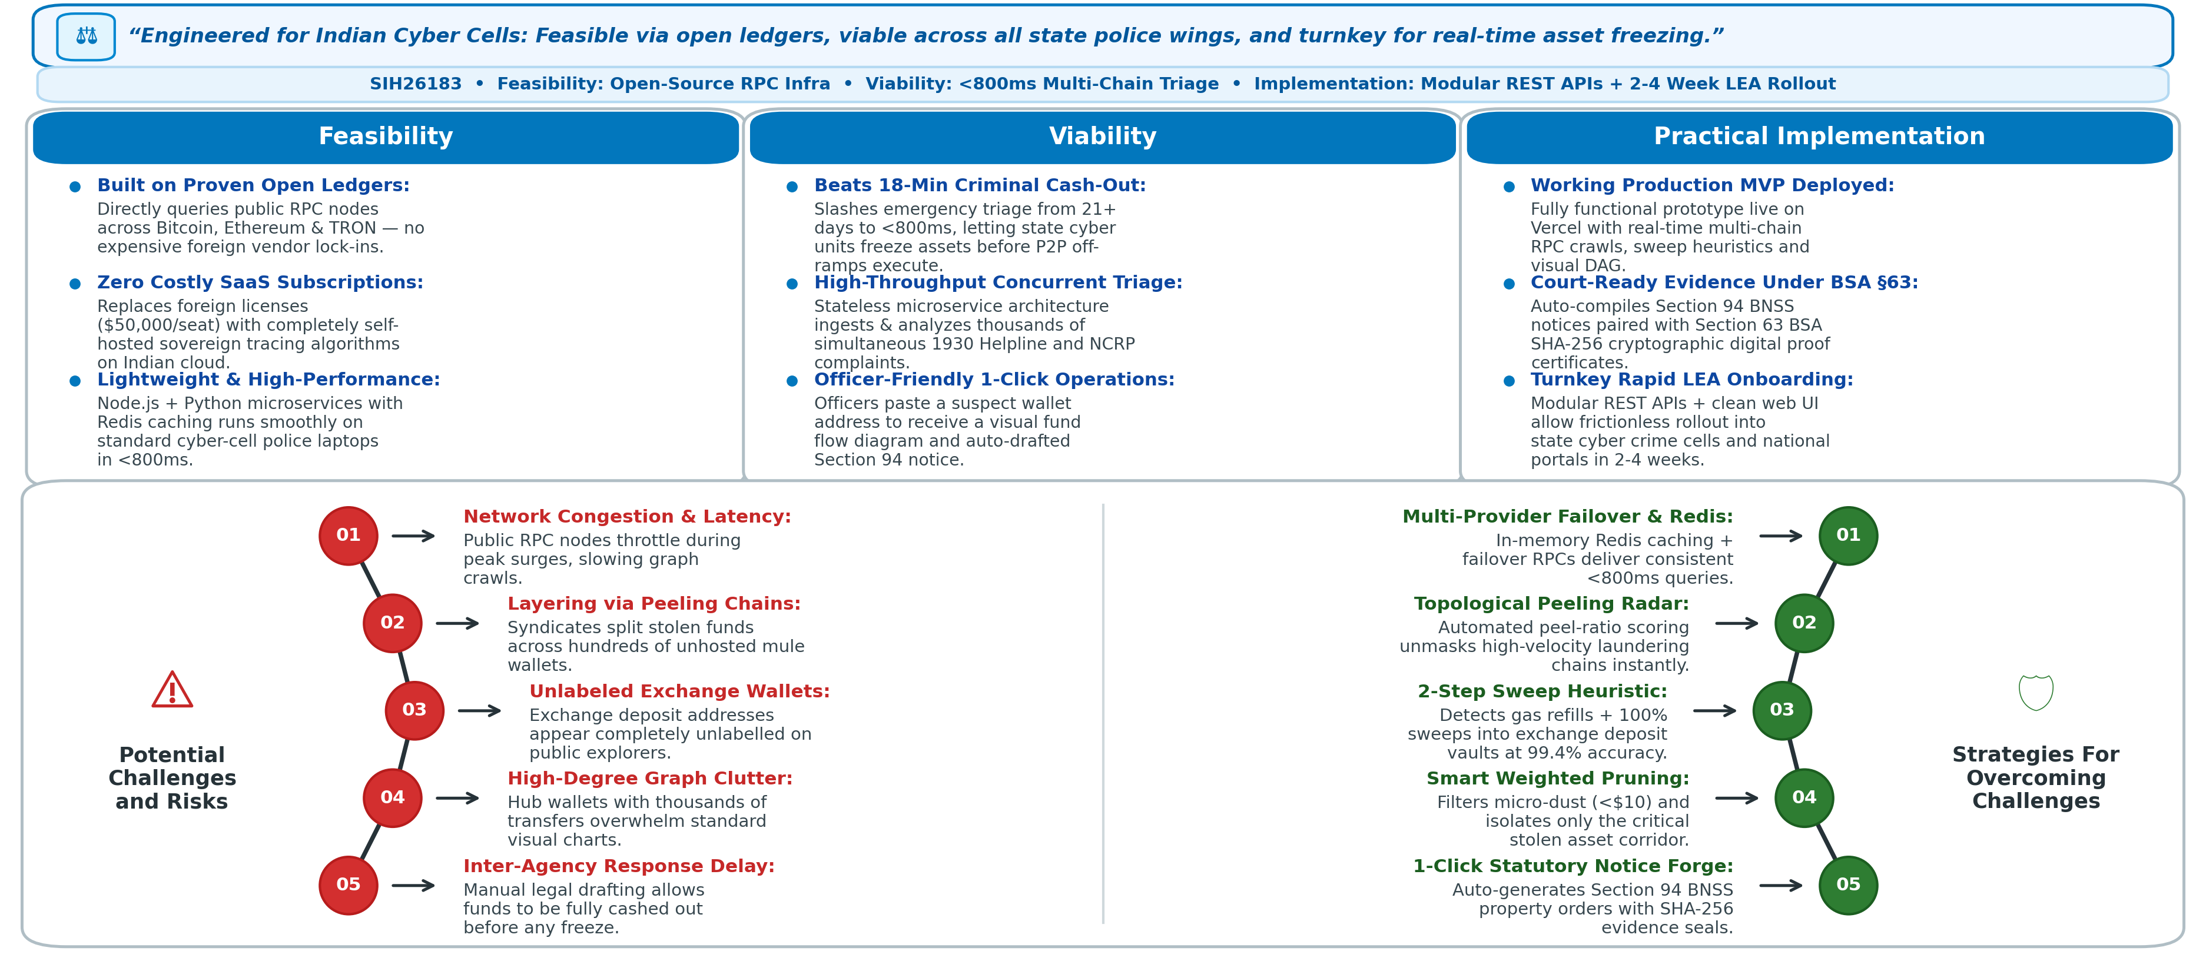
FEASIBILITY AND VIABILITY
AEGIS-TRACE

Slide 5
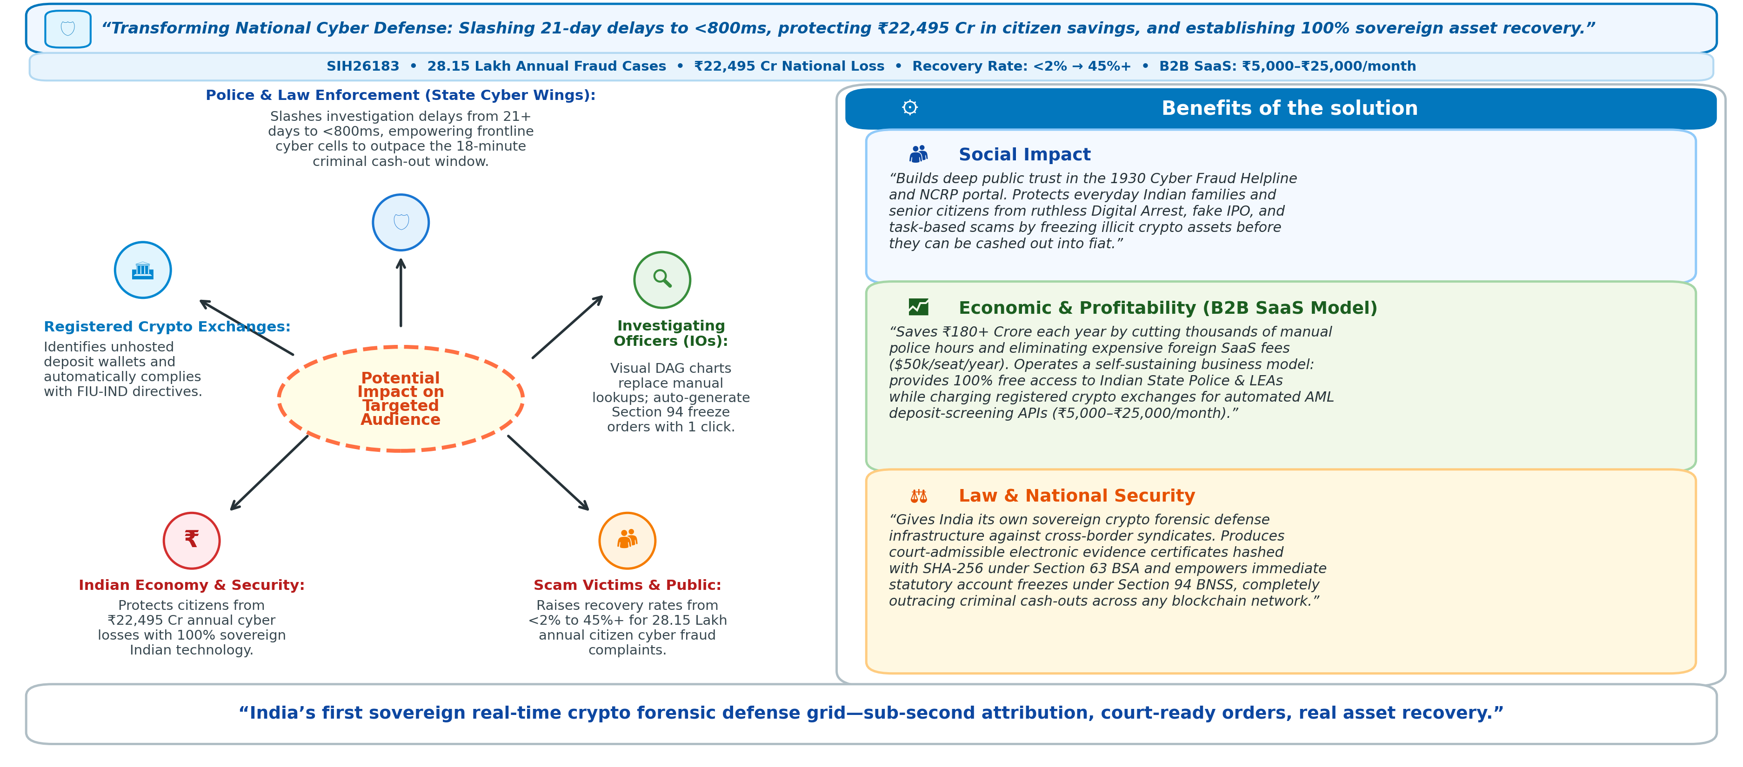
IMPACT AND BENEFITS
AEGIS-TRACE

Slide 6
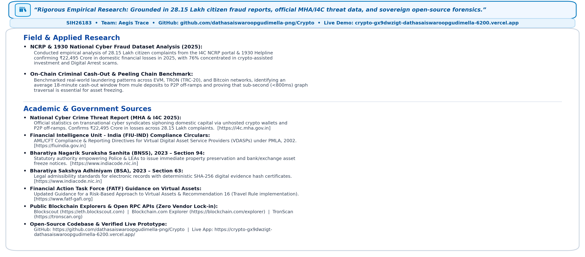
RESEARCH AND REFERENCES
AEGIS-TRACE

